Slide 1
Log Regression and SVM in python
With cross validation

Slide 2
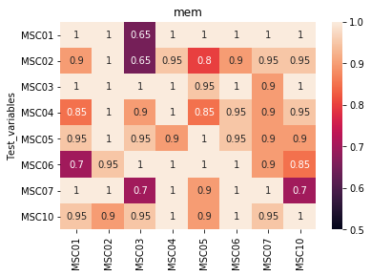
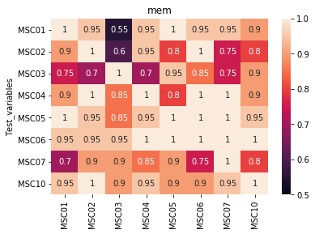
SVM
Log Regression

Slide 3
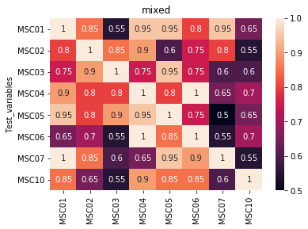
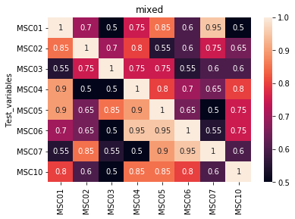
SVM
Log Regression

Slide 4
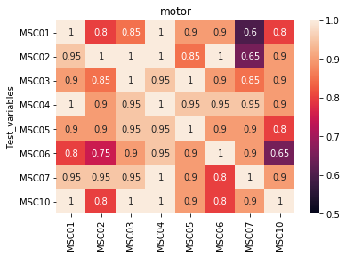
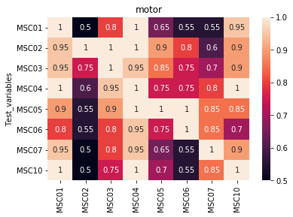
SVM
Log Regression

Slide 5
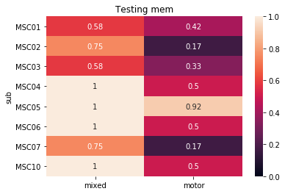
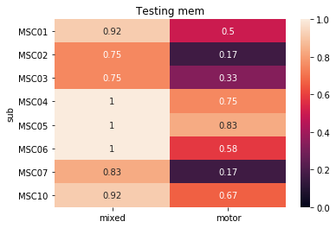
SVM
Logistic Regression

Slide 6
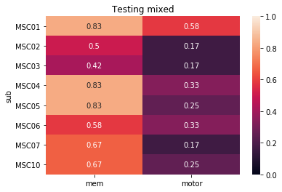
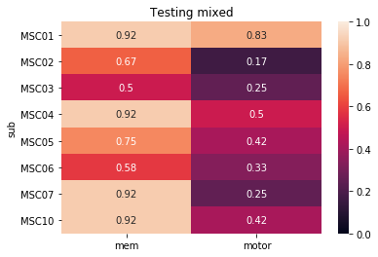
SVM
Logistic Regression

Slide 7
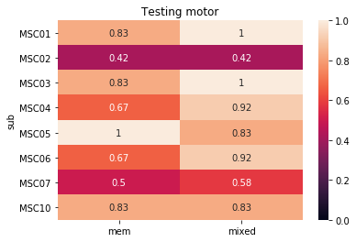
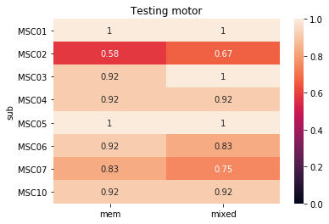
SVM
Logistic Regression

Slide 8
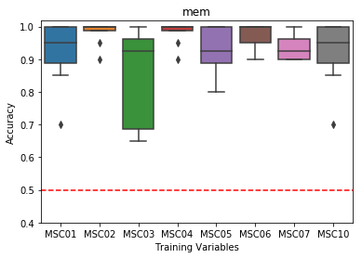
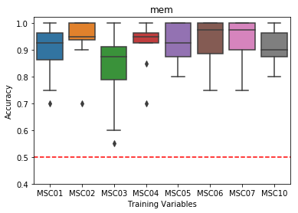
Boxplots Accuracy per training between subjects
SVM
Log Regression

Slide 9
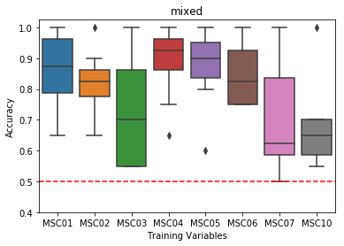
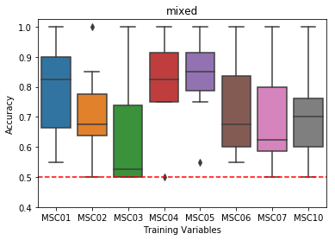
SVM
Log Regression

Slide 10
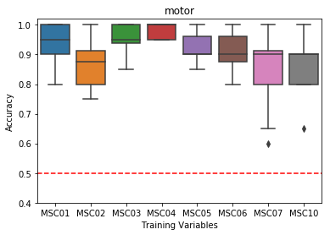
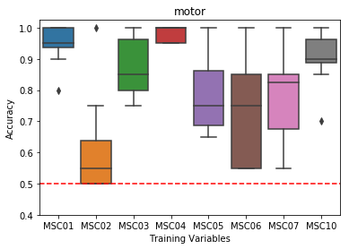
SVM
Log Regression

Slide 11
Mean Accuracy Between Models

Slide 12
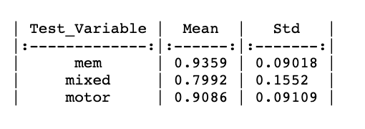
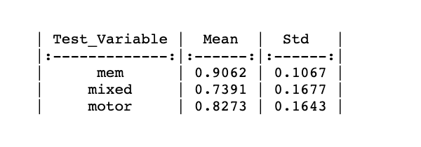
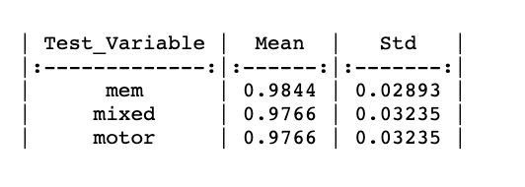
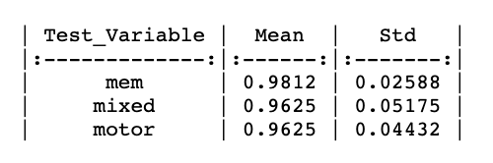
Between subject within task analysis
SVM
Log Regression
Within subject within task analysis
SVM
Log Regression

Slide 13
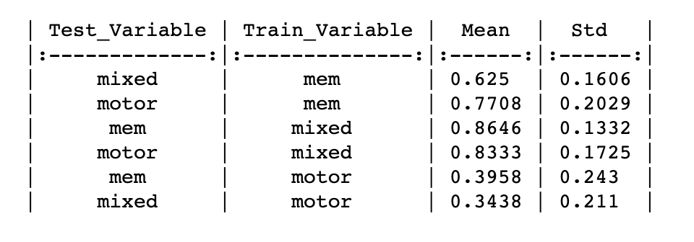
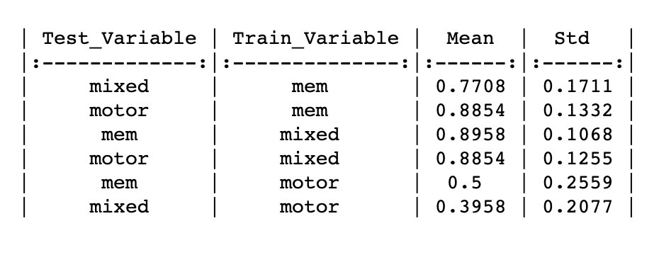
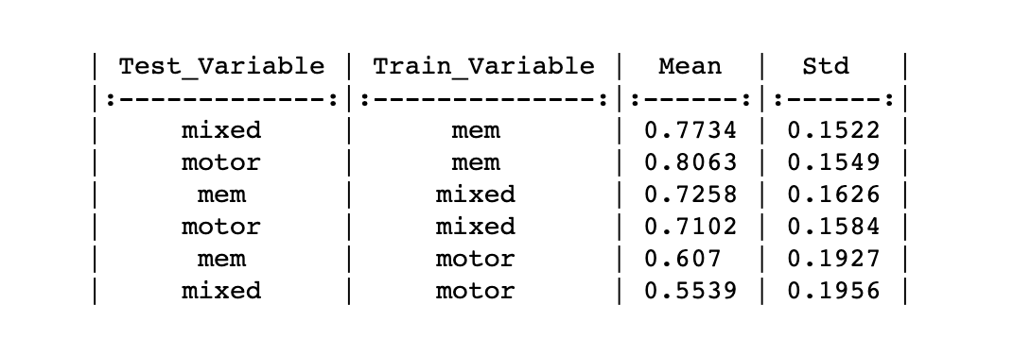
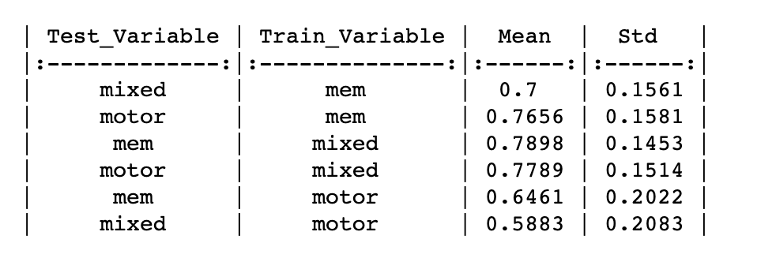
Within subject between task analysis
SVM
Log Regression
Between subject between task analysis

Slide 14
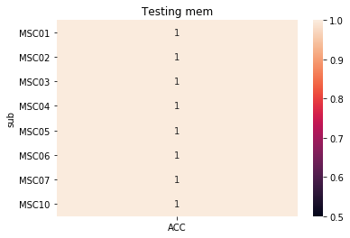
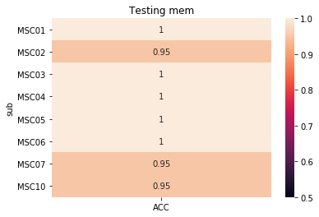
Within sub within task acc
SVM
Log Regression

Slide 15
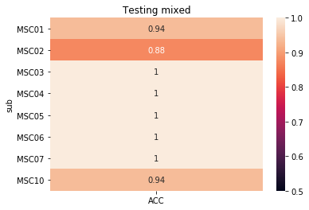
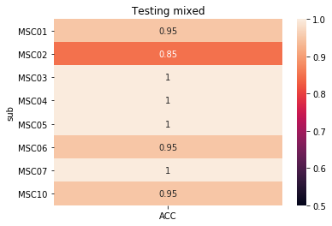
Within sub within task acc
SVM
Log Regression

Slide 16
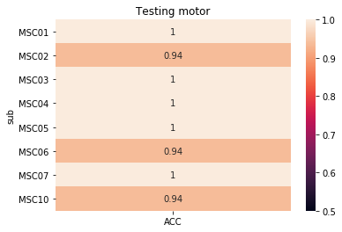
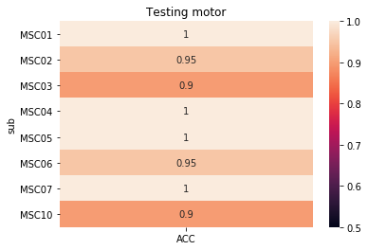
Within sub within task acc
Log Regression
SVM

Slide 17
Feature weights svm

Slide 18
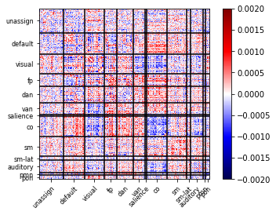
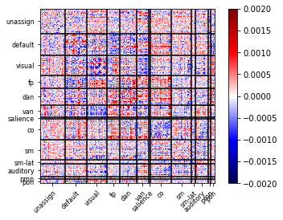
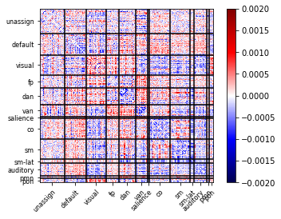
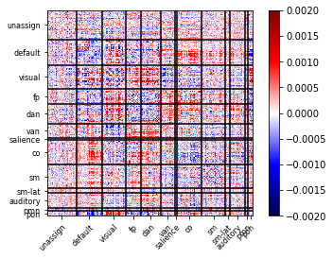
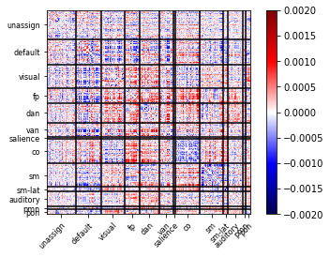
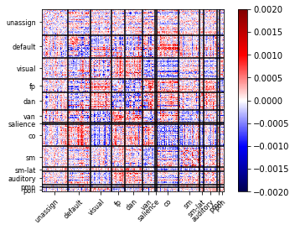
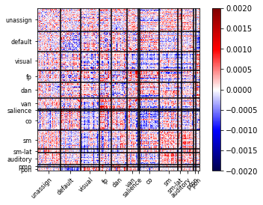
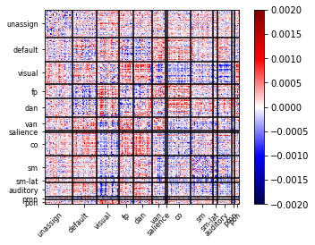
Memory Task Rest
MSC01
MSC02
MSC03
MSC04
MSC06
MSC07
MSC10
MSC05

Slide 19
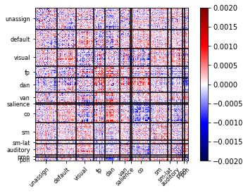
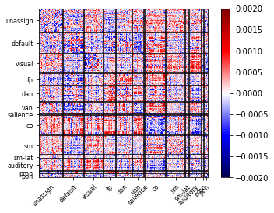
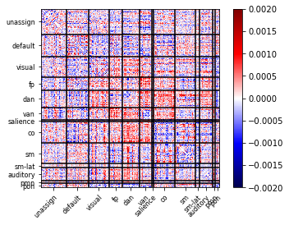
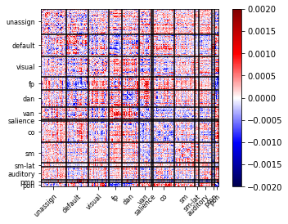
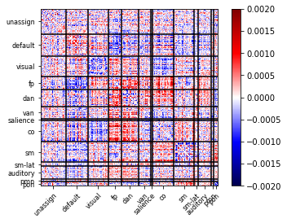
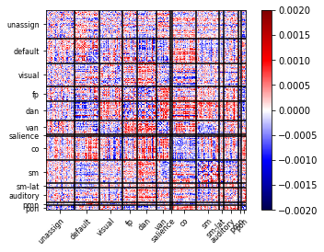
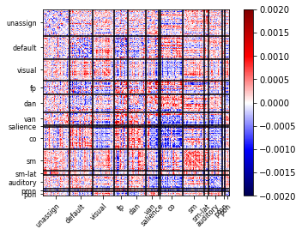
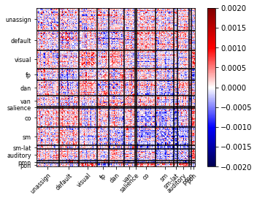
Mixed Task Rest
MSC02
MSC03
MSC04
MSC01
MSC05
MSC06
MSC07
MSC10

Slide 20
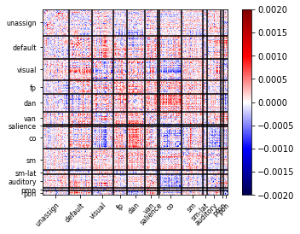
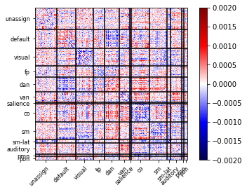






Motor Task Rest
MSC01
MSC02
MSC03
MSC04
MSC07
MSC10
MSC05
MSC06

Slide 21
Feature weights log regression

Slide 22








Memory Task Rest
MSC01
MSC02
MSC03
MSC04
MSC05
MSC06
MSC07
MSC10

Slide 23








Mixed Task Rest
MSC01
MSC02
MSC03
MSC04
MSC05
MSC06
MSC07
MSC10

Slide 24








Motor Task Rest
MSC01
MSC02
MSC03
MSC04
MSC05
MSC06
MSC07
MSC10

Slide 25
Standard deviation between folds in SVM

Slide 26








Memory
MSC01
MSC02
MSC03
MSC04
MSC05
MSC06
MSC07
MSC10
Notes:
Standard deviation between folds for each sub in memory task suggesting that these values don’t vary much between folds

Slide 27








Mixed
MSC01
MSC02
MSC03
MSC04
MSC05
MSC06
MSC07
MSC10

Slide 28








Motor
MSC01
MSC02
MSC03
MSC04
MSC05
MSC06
MSC07
MSC10

Slide 29
SD between folds in Log Regression

Slide 30








Memory
MSC01
MSC02
MSC03
MSC04
MSC05
MSC06
MSC07
MSC10

Slide 31








Mixed
MSC01
MSC02
MSC03
MSC04
MSC05
MSC06
MSC07
MSC10

Slide 32








Motor
MSC01
MSC02
MSC03
MSC04
MSC05
MSC06
MSC07
MSC10

Slide 33

Splitting data $≠$ better accuracy Debugging MSC02 accuracy

Slide 34


SVM MSC02 train motor test mem split up into 20

Slide 35


SVM MSC02 train motor test mixed split up into 20

Slide 36


Log regression MSC02 train motor test mixed split up into 20

Slide 37


Log regression MSC02 train motor test mem split up into 20

Slide 38
Match rest time to motor task

Slide 39

SVM MSC02 train motor test mixed matching rest with the motor task time

Slide 40

SVM MSC02 train motor test memory matching rest with the motor task time

Slide 41

Log regression MSC02 train motor test mixed matching rest with the motor task time

Slide 42
Log regression MSC02 train motor test memory matching rest with the motor task time

Slide 43
Different subject different task SVM

Slide 44



Slide 45



Slide 46



Slide 47
Different subject different task log regression

Slide 48



Slide 49



Slide 50



